Slide 1

Geometry
Unit 4, Lesson 4 Written Descriptions of a Sequence of Transformations Volume 1, pg. 195

Slide 2


Benchmarks
MA.912.GR.2.1 Given a preimage and image, describe the transformation and represent the transformation algebraically using coordinates.
MA.912.GR.2.5 Given a geometric figure and a sequence of transformations, draw the transformed figure on a coordinate plane.
volume 1, pg. 195

Slide 3
Integrated Mathematical Thinking and Reasoning Standards
MA.K12.MTR.1.1 Actively participate in effortful learning both individually and collectively.
MA.K12.MTR.4.1 Engage in discussions that reflect on the mathematical thinking of self and others.
MA.K12.MTR.5.1 Use patterns and structure to help understand and connect mathematical concepts.
MA.K12.MTR.6.1 Assess the reasonableness of solutions.
volume 1, pg. 195

Slide 4

Learning Targets
I can draw an image given a pre-image and a written description of a sequence of transformations on a coordinate plane.
I can describe a transformation on the coordinate plane using written descriptions.
volume 1, pg. 195

Slide 5

Warm-Up
volume 1, pg. 196

Slide 6

4.4.1 Warm-Up: Notice and Wonder
A kaleidoscope is an instrument that contains loose bits of colored material, usually glass, between two flat plates and two plane mirrors. The plates can be moved so the colored material changes position. The mirrors then reflect the material in an endless variety of patterns.
What do you notice about the pattern from the kaleidoscope in the picture?
What do you wonder about the pattern?
volume 1, pg. 196

Slide 7

Collaboration
volume 1, pg. 196

Slide 8

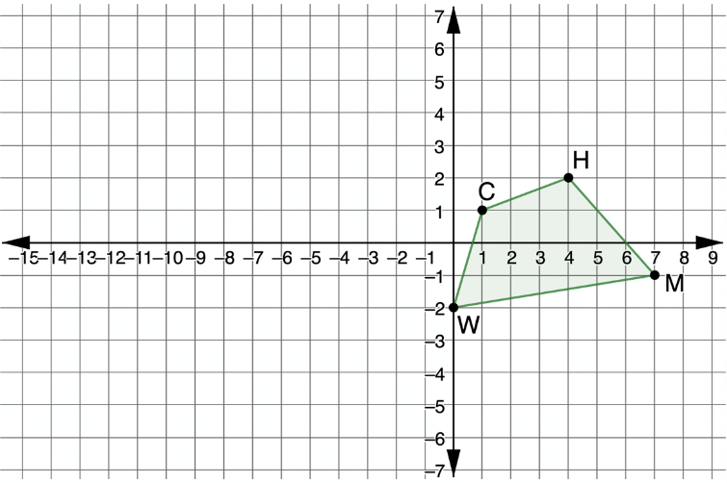
4.4.2 Collaboration: Drawing the Image
Quadrilateral $CHMW$ is shown on the coordinate grid.
Draw the quadrilateral that is the result of a reflection across the $y$ -axis and then translated left 3 and up 1. Label the new quadrilateral $BVXN$.
volume 1, pg. 196

Slide 9

Check your graph with your partner. Make any necessary adjustments.
Work with your partner to explain why quadrilateral $BVXN$ is a result of a sequence of transformations.
A sequence of transformations, or a composition of transformations, is when two or more transformations are combined.
volume 1, pg. 196

Slide 10
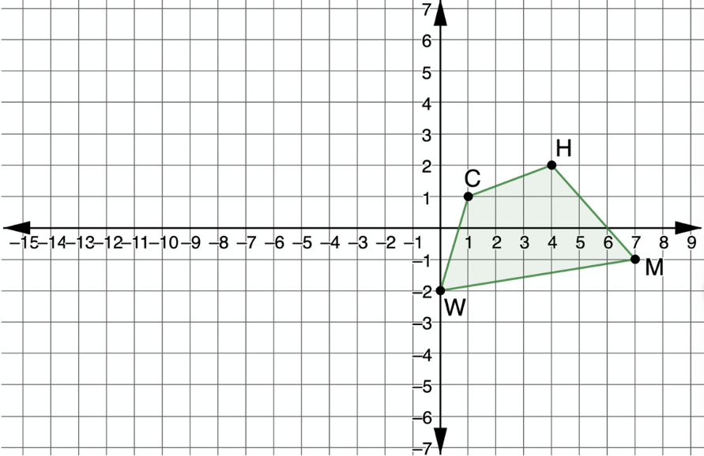
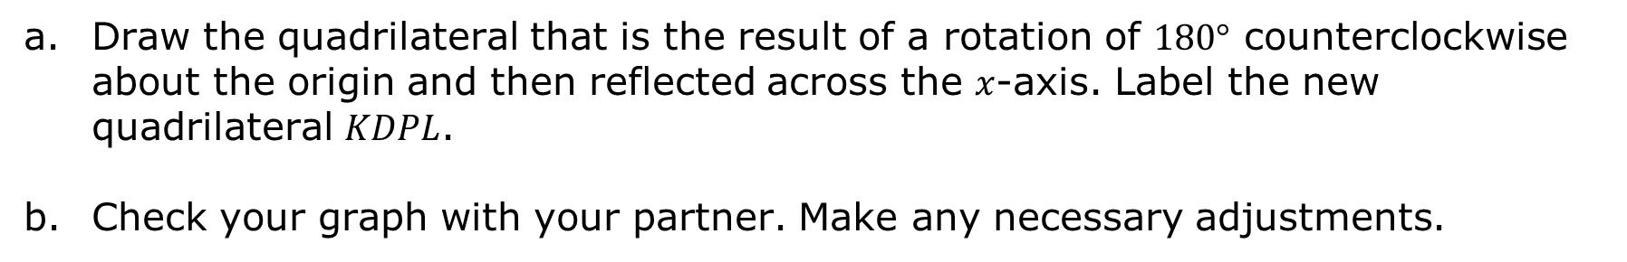
Quadrilateral $CHMW$ is shown on the coordinate grid.
Draw the quadrilateral that is the result of a rotation of $180°$ counterclockwise about the origin and then reflected across the $x$-axis. Label the new quadrilateral $KDPL$.
Check your graph with your partner. Make any necessary adjustments.
volume 1, pg. 197

Slide 11
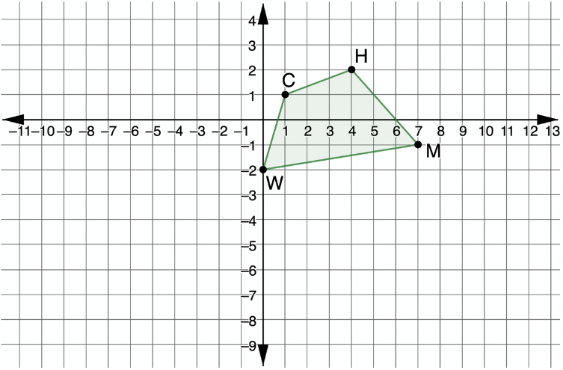
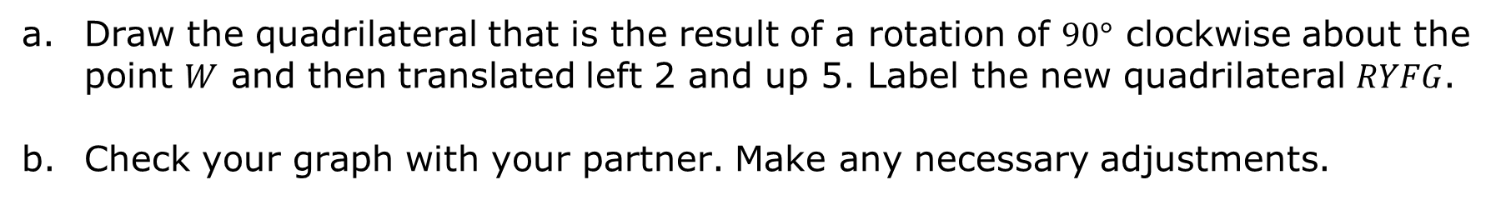
Quadrilateral $CHMW$ is shown on the coordinate grid.
Draw the quadrilateral that is the result of a rotation of $90°$ clockwise about the point $W$ and then translated left 2 and up 5. Label the new quadrilateral $RYFG$.
Check your graph with your partner. Make any necessary adjustments.
volume 1, pg. 197

Slide 12
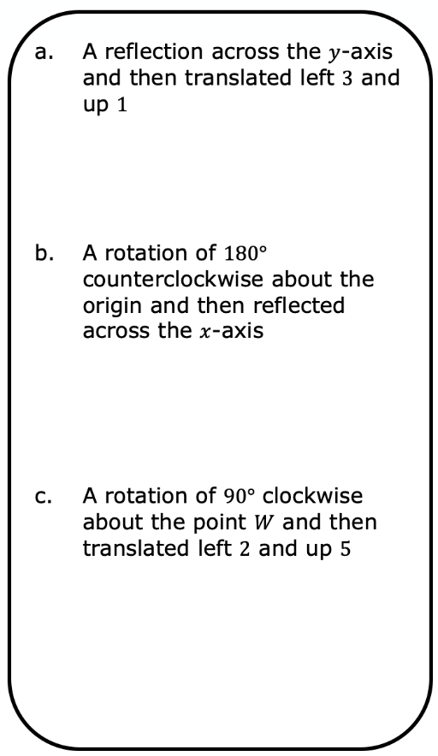

For each sequence of transformations, summarize your mistakes and what you learned from them.
volume 1, pg. 198

Slide 13

Guided Instruction
volume 1, pg. 198

Slide 14
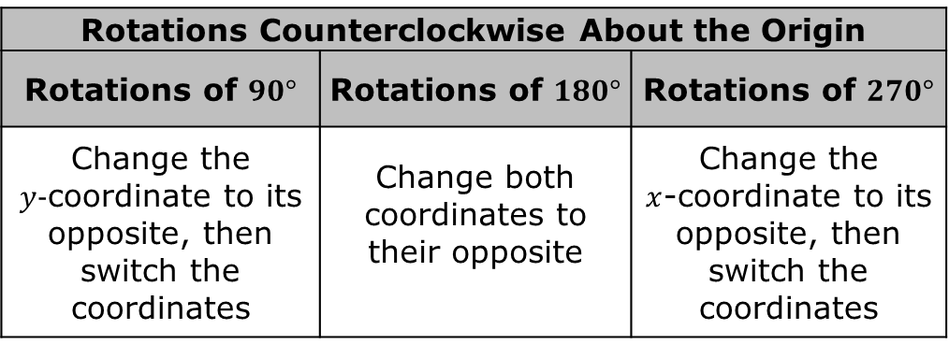
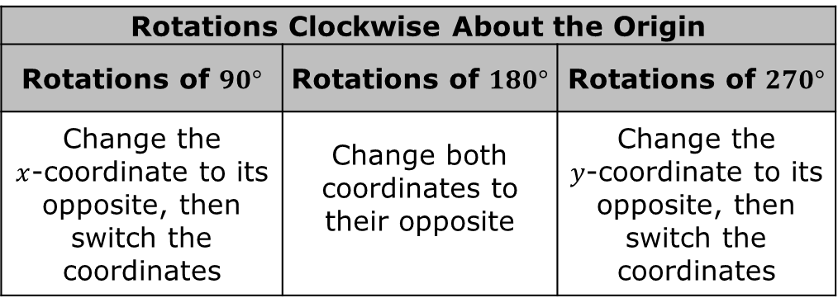
4.4.3 Guided Instruction: Using Coordinates
The Effect of Transformations on Coordinates
Rotations Clockwise About the Origin
Rotations of $90°$ | Rotations of $180°$ | Rotations of $270°$
Change the $x$‑coordinate to its opposite, then switch the coordinates | Change both coordinates to their opposite | Change the $y$‑coordinate to its opposite, then switch the coordinates
Rotations Counterclockwise About the Origin
Rotations of $90°$ | Rotations of $180°$ | Rotations of $270°$
Change the $y$‑coordinate to its opposite, then switch the coordinates | Change both coordinates to their opposite | Change the $x$‑coordinate to its opposite, then switch the coordinates
volume 1, pg. 198

Slide 15
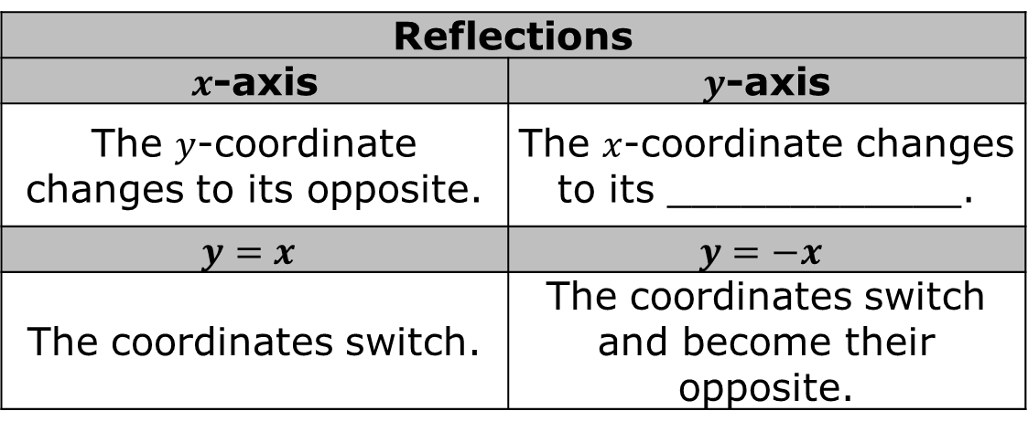
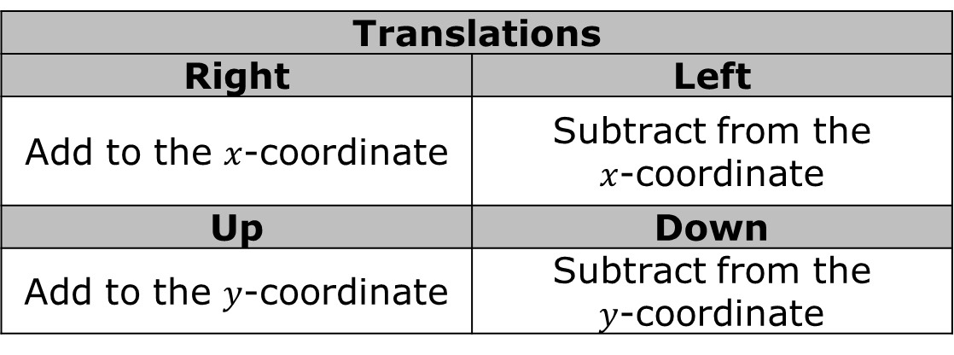
Translations
Right | Left
Add to the $x$‑coordinate | Subtract from the $x$‑coordinate
Up | Down
Add to the $y$‑coordinate | Subtract from the $y$‑coordinate
Reflections
$x$-axis | $y$-axis
The $y$‑coordinate changes to its opposite. | The $x$‑coordinate changes to its ____________.
$$y=x$$ | $$y=−x$$
The coordinates switch. | The coordinates switch and become their opposite.
volume 1, pg. 198

Slide 16
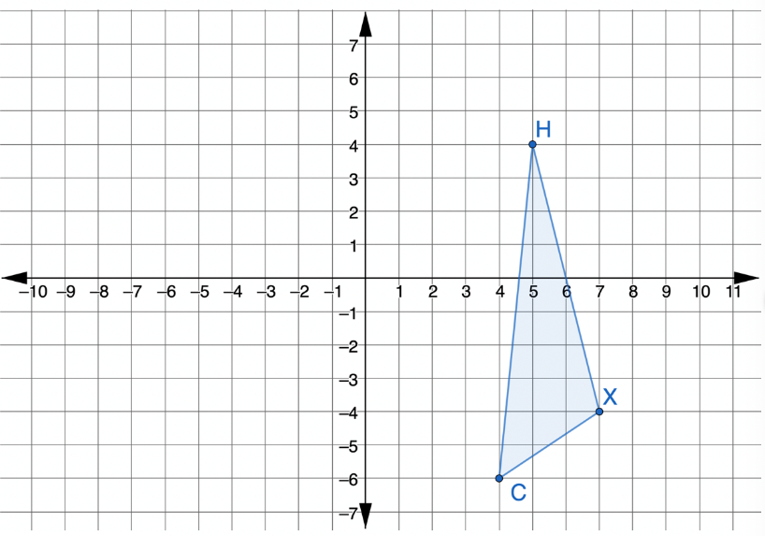
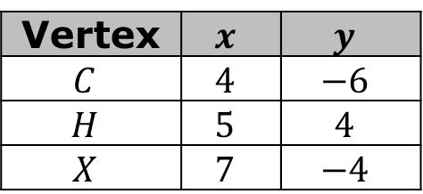

Triangle $CHX$ is shown on the coordinate grid.
Triangle $CHX$
Vertex | $$x$$ | $$y$$
$$C$$ | $$4$$ | $$−6$$
$$H$$ | $$5$$ | $$4$$
$$X$$ | $$7$$ | $$−4$$
volume 1, pg. 199

Slide 17


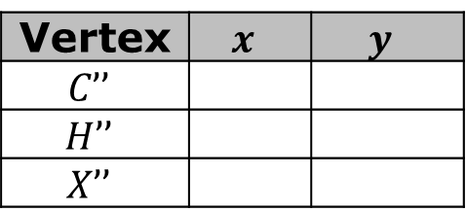
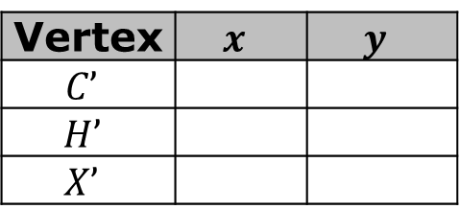
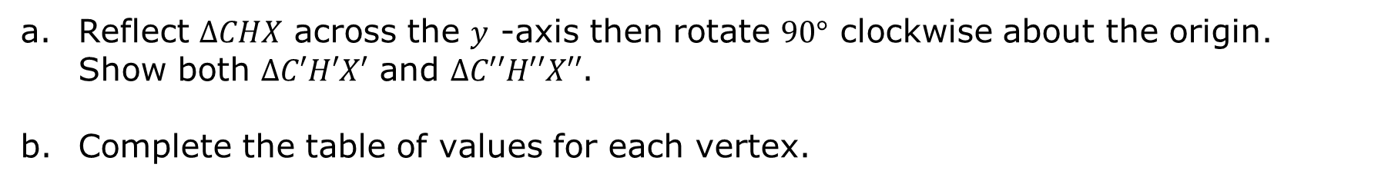
Reflect $∆CHX$ across the $y$ -axis then rotate $90°$ clockwise about the origin. Show both $∆C′H′X′$ and $∆C′′H′′X′′$.
Complete the table of values for each vertex.
Triangle $C′H′X′$
Triangle $C′′H′′X′′$
Vertex | $$x$$ | $$y$$
$$C’$$
$$H’$$
$$X’$$
Vertex | $$x$$ | $$y$$
$$C’’$$
$$H’’$$
$$X’’$$
Discuss with your partner how the tables show the effect of transformations on coordinates.
volume 1, pg. 199

Slide 18

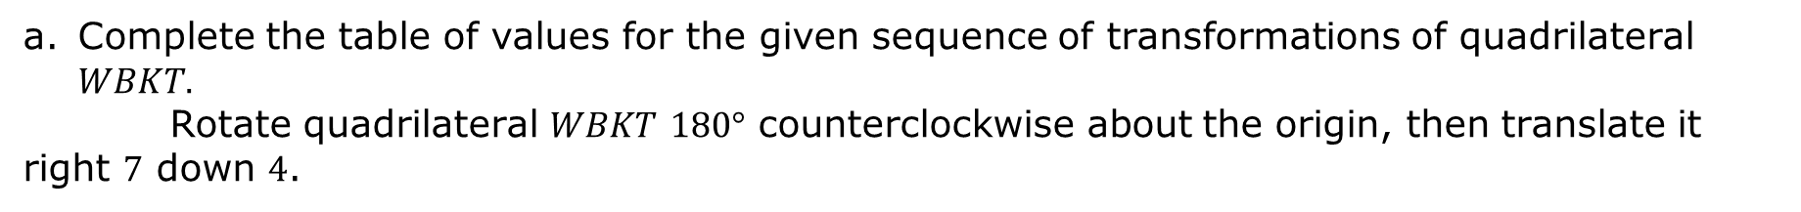

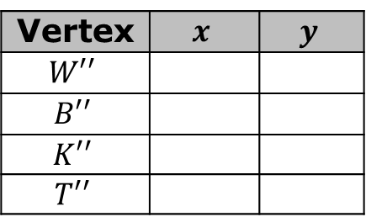
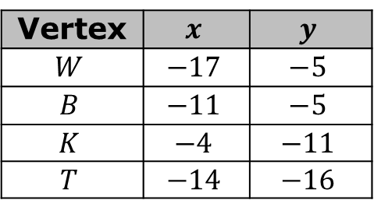
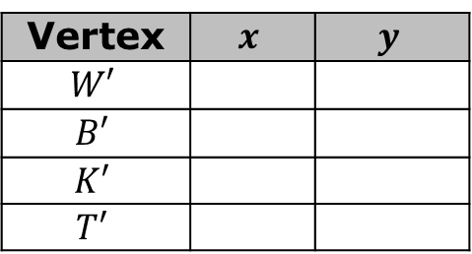
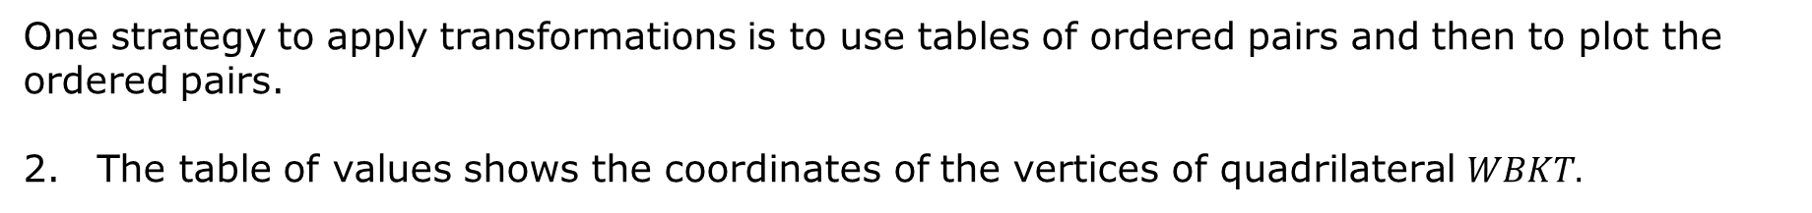

One strategy to apply transformations is to use tables of ordered pairs and then to plot the ordered pairs.
The table of values shows the coordinates of the vertices of quadrilateral $WBKT.$
Quadrilateral $WBKT$
Vertex | $$x$$ | $$y$$
$$W$$ | $$−17$$ | $$−5$$
$$B$$ | $$−11$$ | $$−5$$
$$K$$ | $$−4$$ | $$−11$$
$$T$$ | $$−14$$ | $$−16$$
Complete the table of values for the given sequence of transformations of quadrilateral $WBKT.$
Rotate quadrilateral $WBKT$ $180°$ counterclockwise about the origin, then translate it right $7$ down $4$.
Quadrilateral $W′B′K′T′$
Quadrilateral $W′′B′′K′′T′′$
Vertex | $$x$$ | $$y$$
$$W′$$
$$B′$$
$$K′$$
$$T′$$
Vertex | $$x$$ | $$y$$
$$W′′$$
$$B′′$$
$$K′′$$
$$T′′$$
volume 1, pg. 199

Slide 19
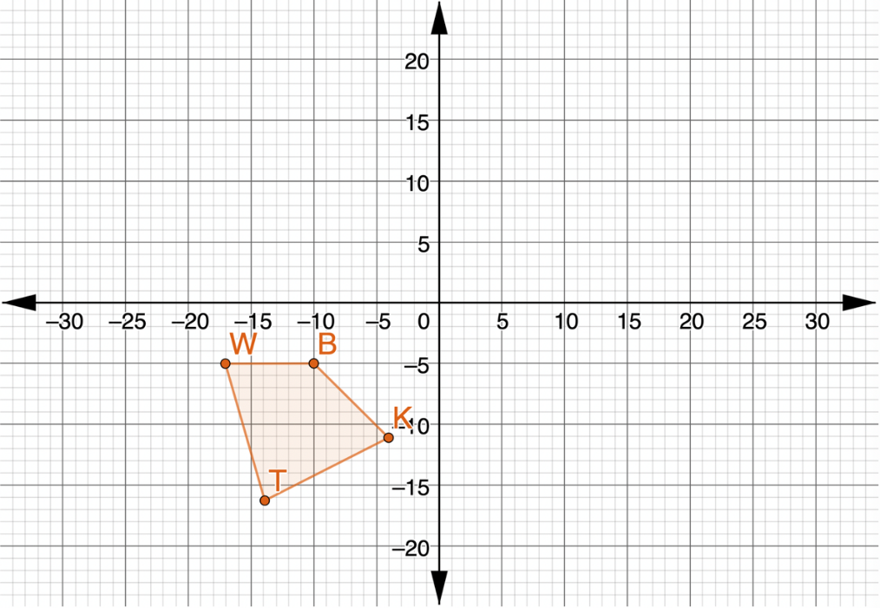
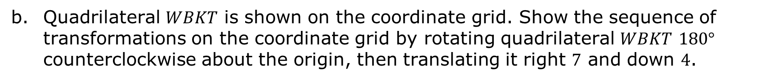
Quadrilateral $WBKT$ is shown on the coordinate grid. Show the sequence of transformations on the coordinate grid by rotating quadrilateral $WBKT$ $180°$ counterclockwise about the origin, then translating it right $7$ and down $4$.
volume 1, pg. 200

Slide 20

Your Turn
volume 1, pg. 200

Slide 21
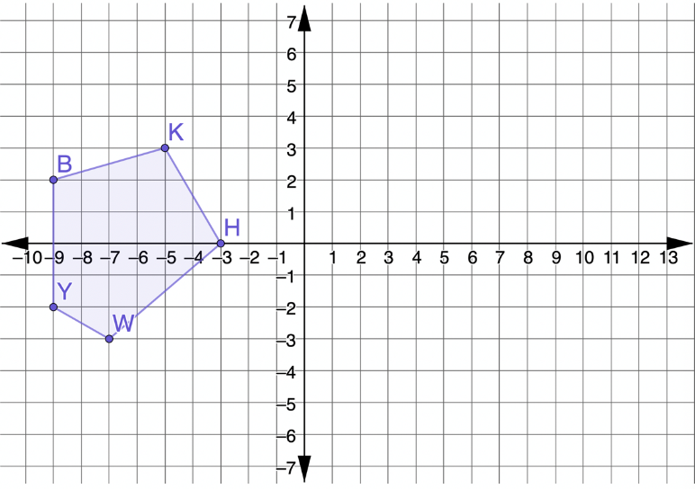
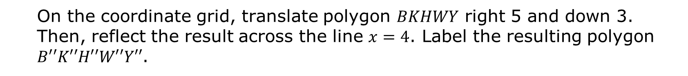
4.4.4 Your Turn!
Polygon $BKHWY$ is shown on the coordinate grid.
On the coordinate grid, translate polygon $BKHWY$ right 5 and down 3. Then, reflect the result across the line $x=4$. Label the resulting polygon $B′′K′′H′′W′′Y′′$.
volume 1, pg. 200

Slide 22

Wrap-Up
volume 1, pg. 201

Slide 23
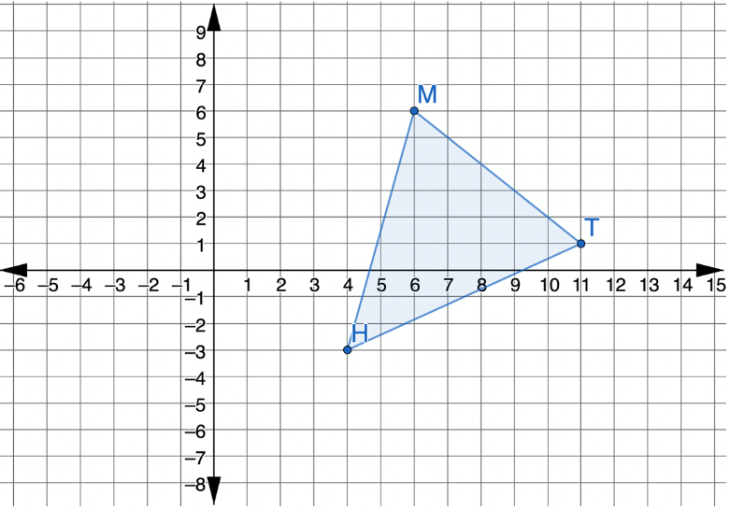
4.4.5 Wrap-Up: Ticket Out the Door
Triangle $HMT$ is shown on the coordinate grid.
Draw $∆BWF$, which is the result of translating $∆HMT$ left 3 and up 3, then rotating the result $90°$ clockwise about the origin.
volume 1, pg. 201

